Slide 1


Get Familiar with Spatial Data

Slide 2
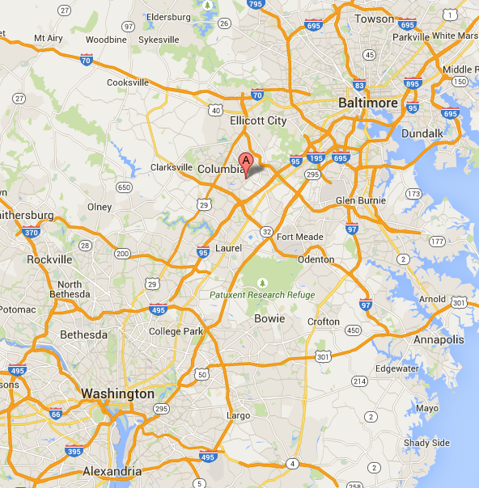




Slava Murygin –
SQL Consultant
@SlavaSQL
SlavaSQL.BlogSpot.com

Slide 3

Introduction

Slide 4
How can we use Spatial Data?
Measurements:
– Length;
– Distance between objects;
– Area of Objects;
Intersection features:
– Area of Intersection;
– Combined/Excluded areas, Etc.
True/False queries, Etc.

Slide 5
Spatial Data Glossary
GIS – Geographic Information System;
OGC – Open Geospatial Consortium – develops GIS standards;
SRID – Spatial Reference ID based on the specific ellipsoid used for either flat-earth mapping or round-earth mapping;
WKT – Well-Known Text;
WKB – Well-Known Binary;
EPSG – European Petroleum Survey Group;
ESRI – Environmental Systems Research Institute –
an international supplier of GIS software;
NAD83 – North American Datum 1983;
WGS84 – World Geodetic System 1984;

Slide 6
Basic Spatial Data Types
Point
LineString
Polygon

Slide 7
Additional Spatial Data Types
CircularString
CompoundCurve
Multipoint
MultiLineString
MultiPolygon
GeometryCollection

Slide 8
Most popular Spatial Data Methods
STGeomFromText – Generates Spatial Data;
STIsValid – Checks if Geo Instance is well formed;
STAsText – Represents Spatial Data as a Text;
STBuffer – Returns a Polygon from 0/1/2 D object;
STArea – Returns total surface area;
STLength – Returns combined perimeter;
STCentroid – Returns the geometric center;
STDistance – Returns distance between two objects;
STIntersection – Returns Intersection object;
STContains – Checks if one object contains another;

Slide 9
Demo 1
Spatial Data Types;
Spatial Data Methods;

Slide 10
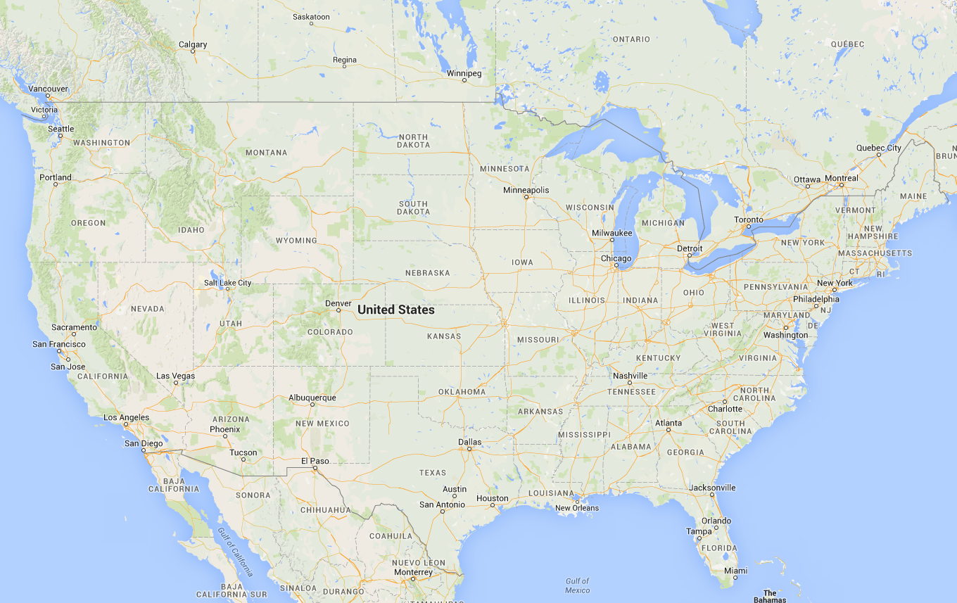
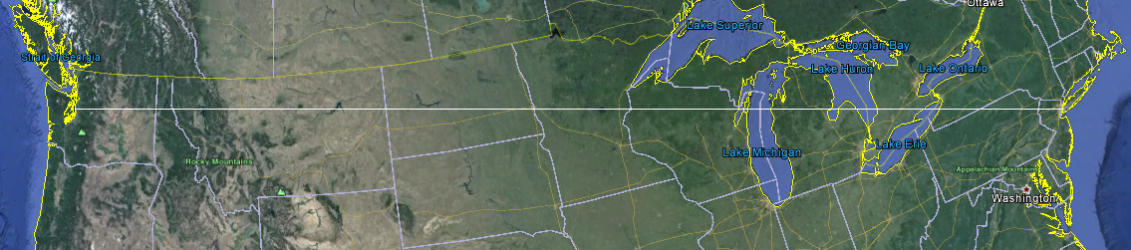
Geometry vs Geography

Slide 11
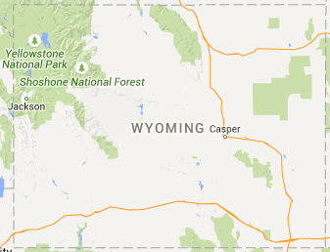
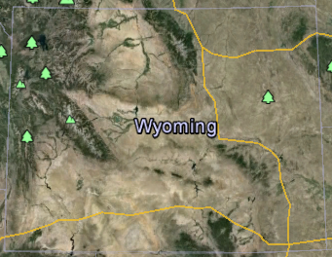
Geometry vs Geography
Earth shape – Spheroid, Elipsoid, Geoid.
Western Border = 276 Miles
Eastern Border = 276 Miles
Northern border
= 343 Miles
Southern border
= 365 Miles

Slide 12
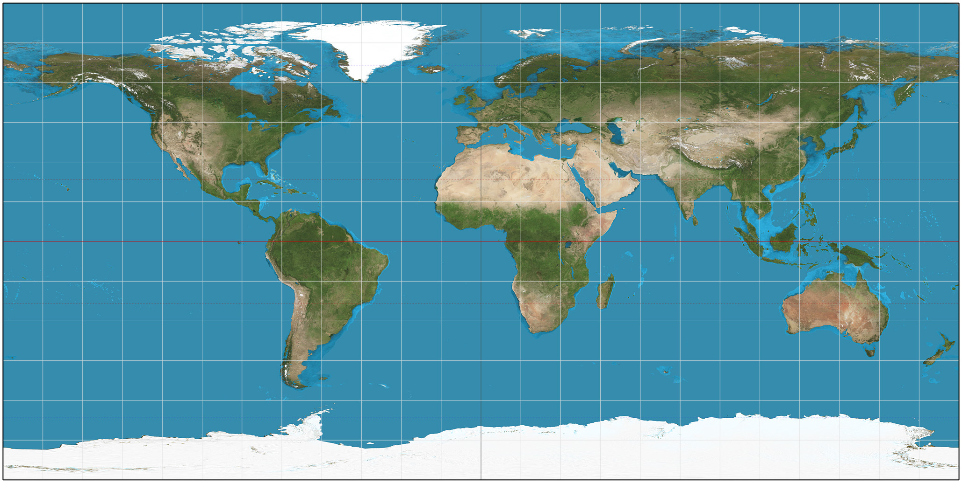
Map Projections
Equirectangular – Simplest geometry; distances along meridians are conserved. Equator as the standard parallel;

Slide 13
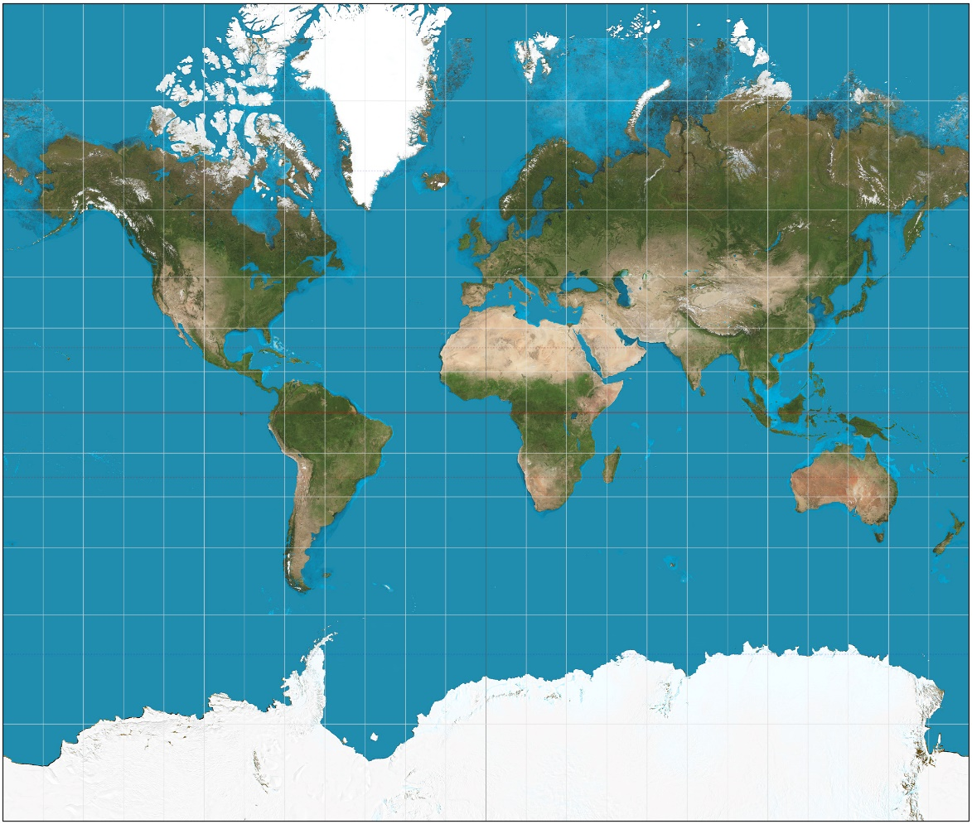
Map Projections
Mercator – Lines of constant bearing are straight, aiding navigation. Areas inflate with latitude, becoming so extreme that the map cannot show the poles.;

Slide 14
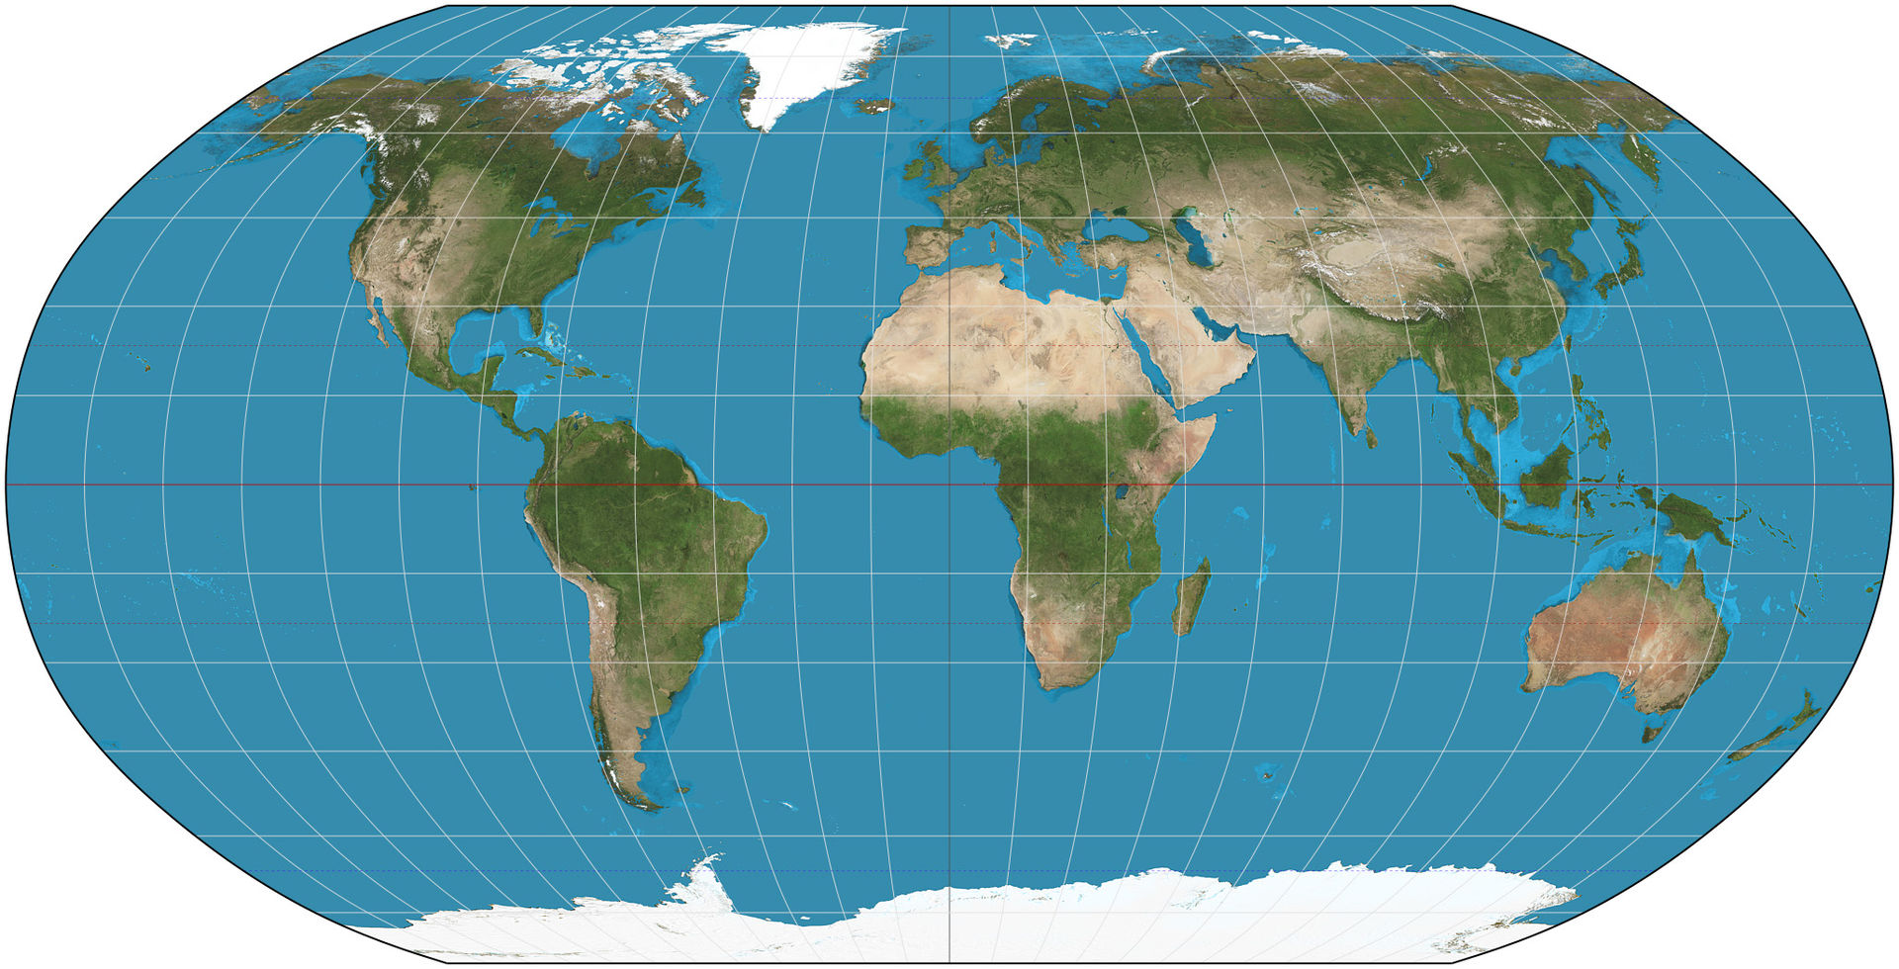
Map Projections
Robinson – Computed by interpolation of tabulated values;

Slide 15

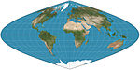
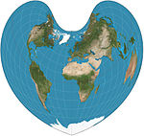
Map Projections
Werner – Distances from the North Pole are correct as are the curved distances along parallels;
Sinusoidal – Meridians are sinusoids; parallels are equally spaced. Aspect ratio of 2:1. Distances along parallels are conserved;
Bonne – General case of both Werner and Sinusoidal;
Armadillo, Lambert conformal conic, Albers conic, Etc.
http://en.wikipedia.org/wiki/List_of_map_projections

Slide 16
Demo 2
Geometry vs Geography;

Slide 17

Geospatial Data Issue
Inaccuracy – Due to landscape and irregular shape;

Slide 18
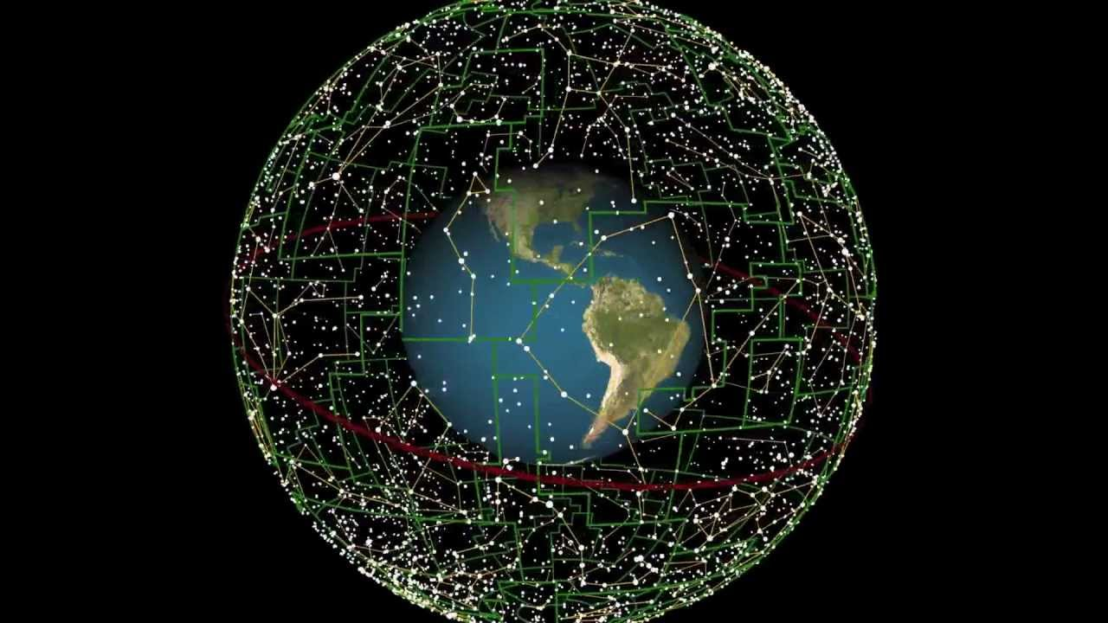
Space Spatial Data – No Issues
Star Map is the Celestial Sphere

Slide 19
Demo 3
Making Star Maps

Slide 20
The End
Slava Murygin
@SlavaSQL
SlavaSQL.BlogSpot.com

Slide 21
Demo 4
Have some Fun!

